Slide 1
C# presentation
Kasim Elina & Nurlanova Aigerim
“Checker game”

Slide 2
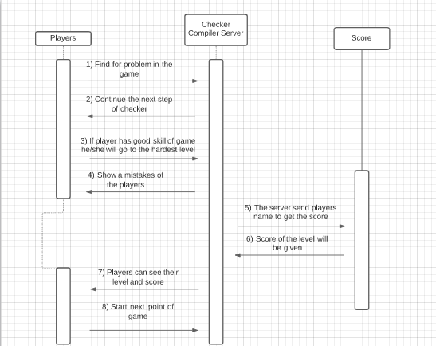
Diagram
Here is the diagram of checker game process.

Slide 3
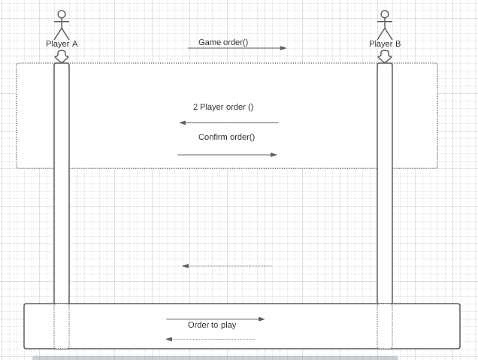
When player chose the game partner for act

Slide 4
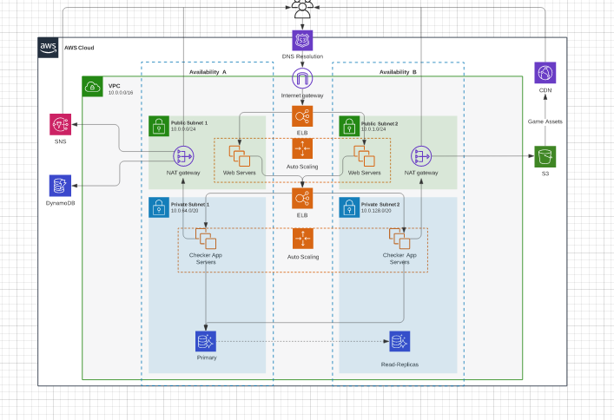
Also checker game can be played online mode, it’s show that players have opportunities play it anywhere

Slide 5
Endpoints
[HttpGet] //endpoints
public List<Player> PlayersName()
{
return players;
}
[HttpGet("PlayerId/{PlayerId}")]
public List<Moves> Movement(int idPlayer)
{
return movement.Where(m => m.PlayerId == idPlayer).ToList();
}
[HttpGet("Difficulty/{Difficulty}")]
public List<Player> PlayerDiff(string diff)
{
return players.Where(p => p.Difficulty == diff).ToList();
}
[HttpGet("{Name}/{Difficulty}")]
public string InfoAbout(string Name, string Difficulty)
{
return "Hello, I'm " + Name + " and my level is " + Difficulty;
}
[HttpGet("Name/{Name}")]
public List<Player> PlayerName(string name)
{
return players.Where(p => p.Name.ToLower() == name.ToLower()).ToList();
}

Slide 6

Future plans make your road easier and clear

Slide 7
Thank you for attention ! ! !

